Slide 1
Provenance and workflows in AiiDA
Sebastiaan P. Huber
Notes:
Widescreen 16:9 (as used by YouTube)

Slide 2

Introduction
Sebastiaan Huber
Post-doc @ EPFL and developer of:
* aiida-core
* aiida-quantumespresso
In this talk
* How and when does AiiDA store provenance?
* Short introduction to writing workflows
* Overview of AiiDA’s provenance model
Notes:
Don't forget to update your name on the right

Slide 3
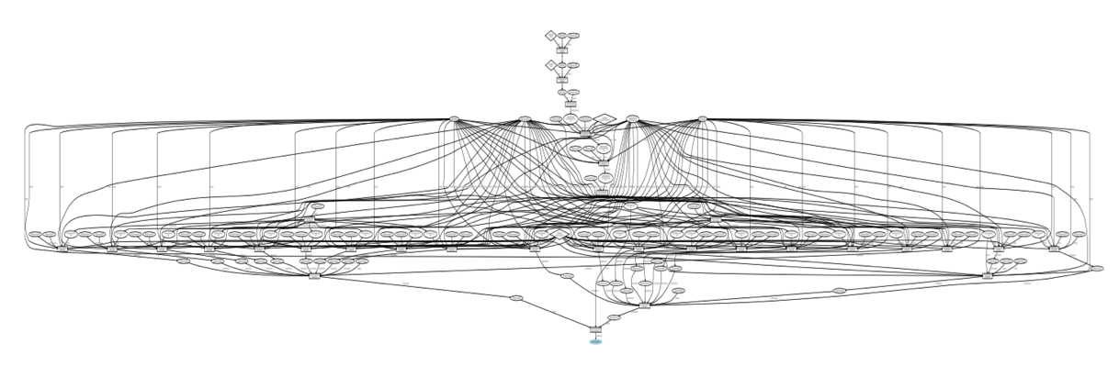
Automated provenance
Keeping data provenance is important…
...but imagine having to manually link everything up
Notes:
Don't forget to update your name on the right

Slide 4

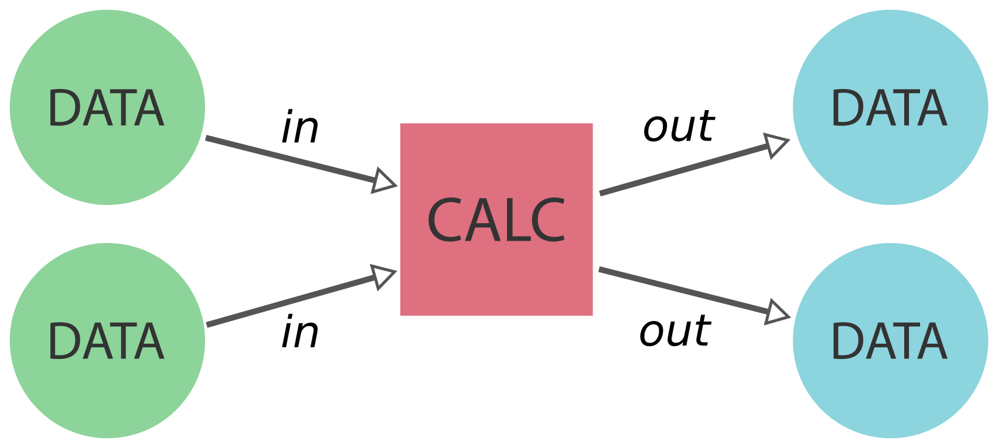
Automated provenance
So how exactly is provenance automatically stored?
Notes:
Don't forget to update your name on the right

Slide 5
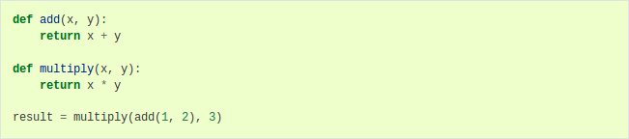
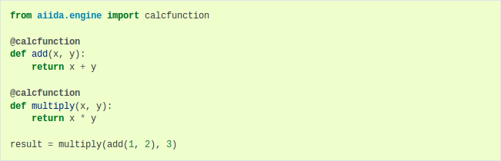
Automated provenance: calculations
Imagine the following simple arithmetic problem:
Add two numbers and multiply the sum by third
Just apply the calcfunction decorator
Notes:
Don't forget to update your name on the right

Slide 6
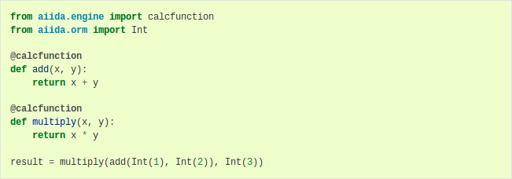
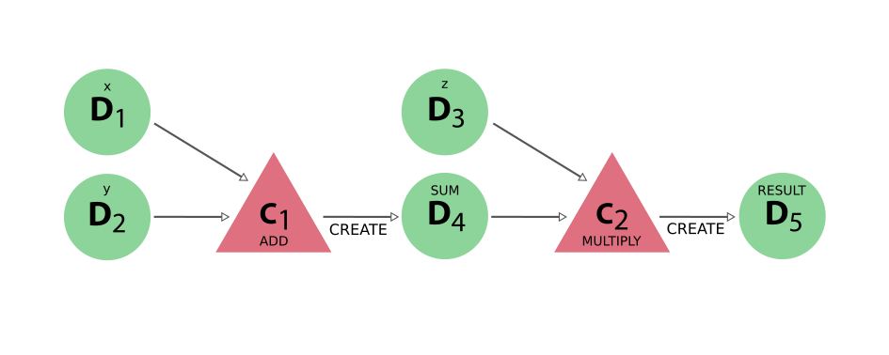
Automated provenance: calculations
Now we just call it like a normal function while passing storable types
The provenance is automatically stored in the database
Directed Acyclic Graph
Directed: inputs go in outputs come out
Acyclic: causality principle forbids an output being its own input
Notes:
Don't forget to update your name on the right

Slide 7
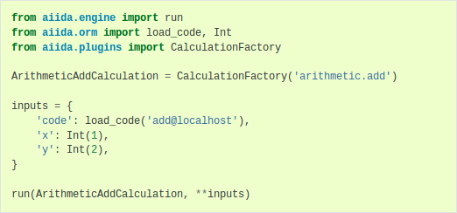
Automated provenance: external codes
But not all code is well-suited as Python code:
What about running external codes through AiiDA?
Implementation is different as it requires a plugin,
but running very similar...
Notes:
Don't forget to update your name on the right

Slide 8
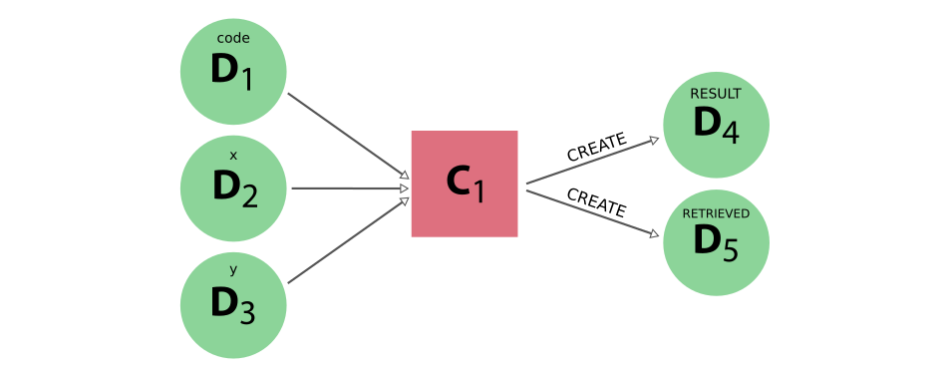
Automated provenance: external codes
Generated provenance similar to that of calculation function
Has additional output node containing the retrieved output files
Can be run on remote machines through job scheduler
Implementation independent of job scheduler
To change machine, just change the ‘code’ input
Many can be run in parallel by submitting to the daemon
Notes:
Don't forget to update your name on the right

Slide 9
Automated provenance: workflows
Let’s go back to the first add-multiply example
Individual sequence of calculations recorded...
... but not the ‘how’ or ‘why’
Notes:
Don't forget to update your name on the right

Slide 10
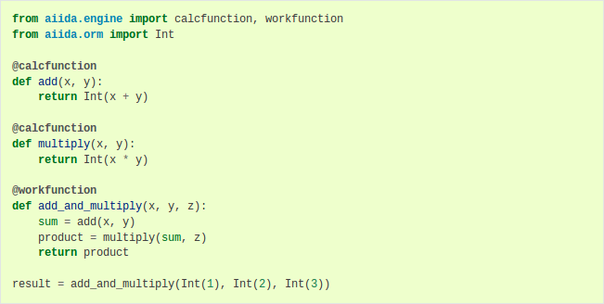
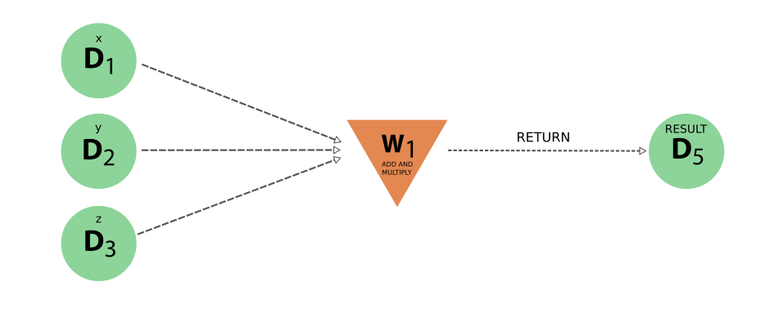
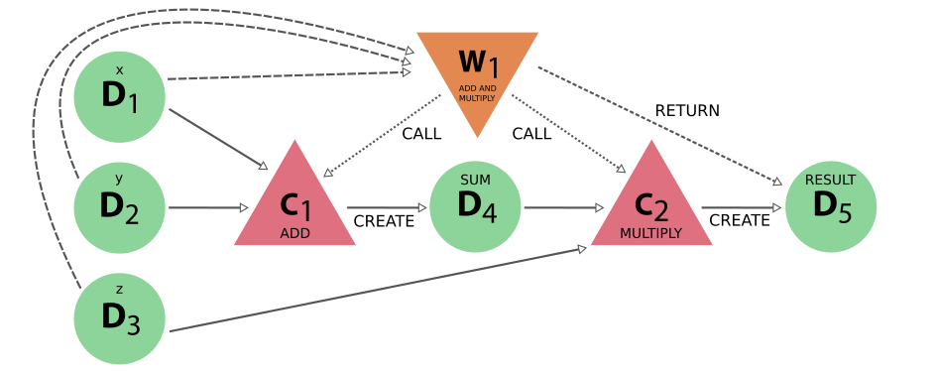
Automated provenance: workflows
Work functions can be used to store logical provenance
We can look at the logical provenance to ‘hide’ the complexity
Or ignore it to retrieve the original data provenance
Notes:
Don't forget to update your name on the right

Slide 11
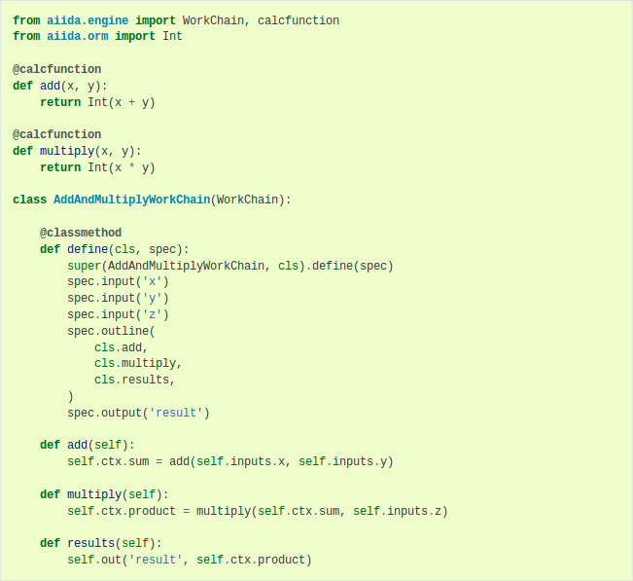
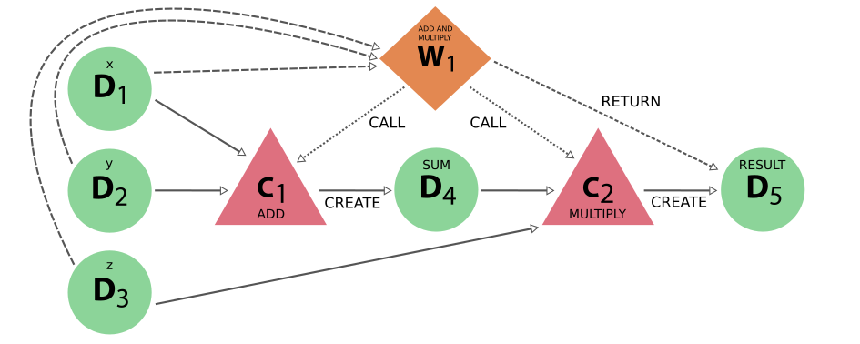
Automated provenance: workflows
Work chains achieve the same but save progress in between steps
Only difference with work function solution is node type
Notes:
Don't forget to update your name on the right

Slide 12
Automated provenance: workflows
Work chains provide many advantages over work functions:
Many can be run in parallel by submitting to the daemon
Progress is saved between steps in checkpoints
Process specification gives succinct but clear summary
Captures the scientific knowledge and can be re-run
Can be re-used as building block in more complex workflows
Notes:
Don't forget to update your name on the right

Slide 13
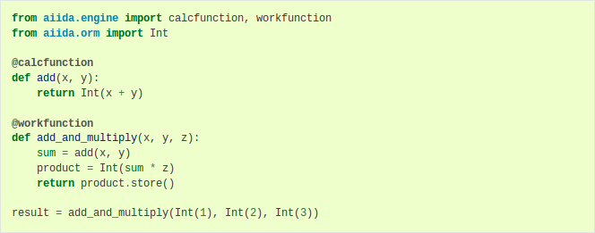
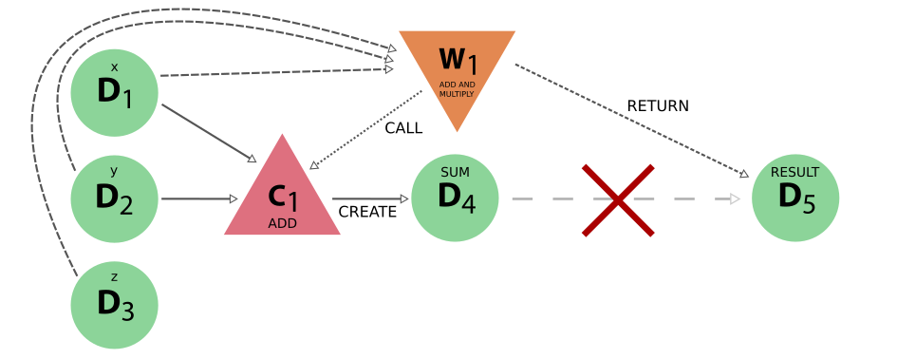
Automated provenance: losing provenance
Workflows cannot create new data.
Doing so anyway, will cause loss of provenance
Take first example: add two numbers and multiply with third...
... but now compute the product inside the work function
Notes:
Don't forget to update your name on the right

Slide 14
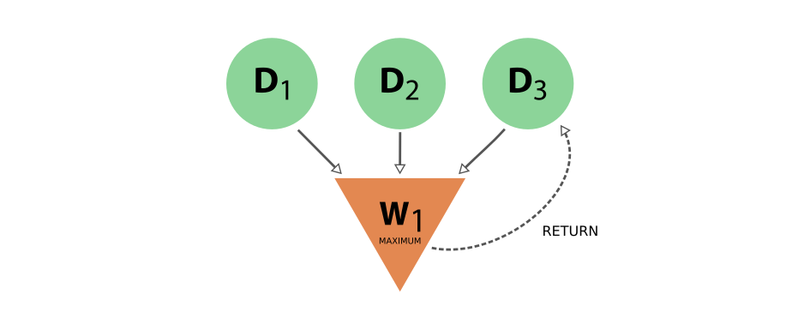
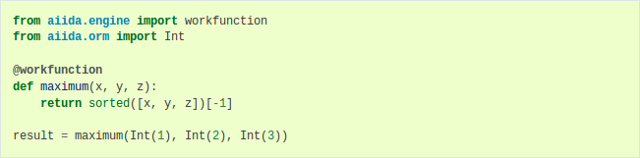
Why a difference between calculations and workflows
Since workflows can return, they can also return their inputs
This breaks the acyclity and therefore the DAG
Two clearly distinct types of processes
CALCULATIONS
WORKFLOWS
Can create new data
Can call other processes
Can return existing data
Notes:
Don't forget to update your name on the right

Slide 15
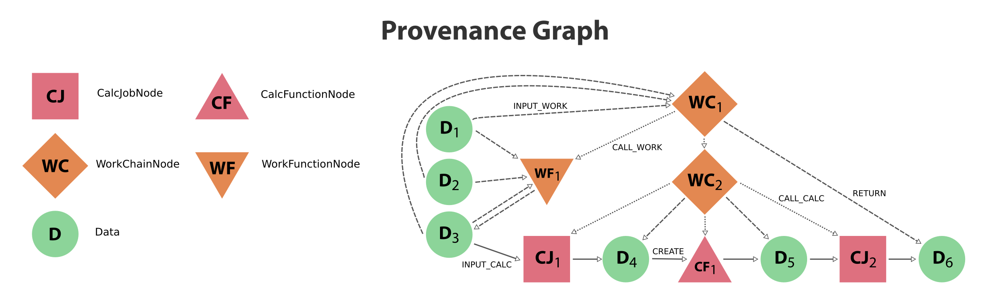
Provenance design: an overview
Notes:
Don't forget to update your name on the right

Slide 16
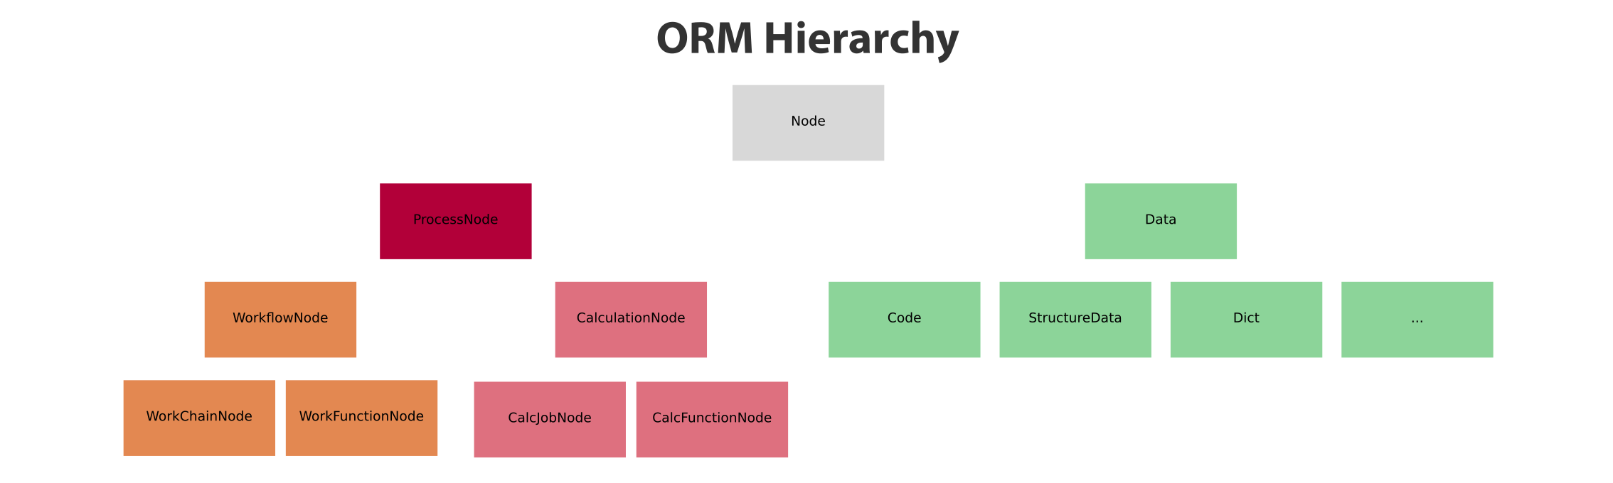
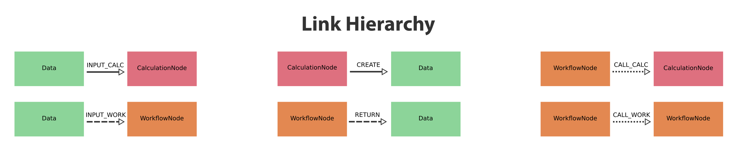
Provenance design: an overview
Notes:
Don't forget to update your name on the right

Slide 17
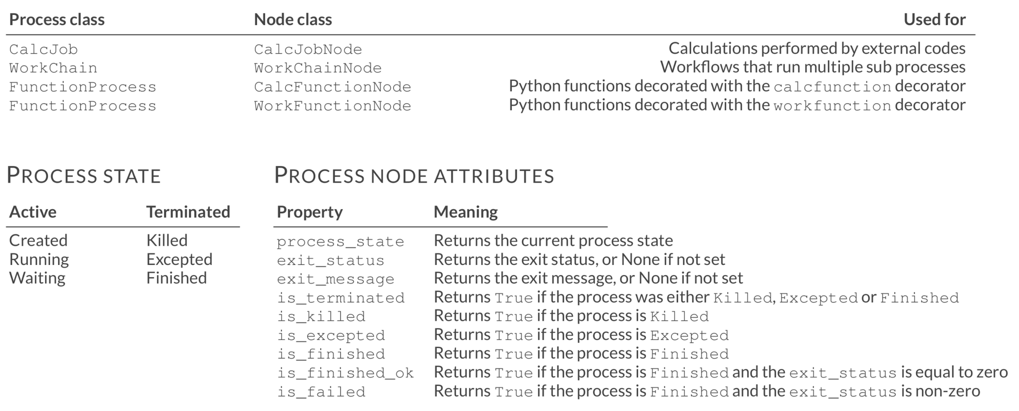
Processes and nodes
The engine runs processes and stores a corresponding node in the database
Notes:
Don't forget to update your name on the right

Slide 18
Launching processes
Four processes launchers with identical interface
run Run blockingly and return result
run_get_node Run blockingly and return result + node
run_get_pk Run blockingly and return result + pk
submit Submit to daemon and return node
Running will block the interpreter, submitting will not as the daemon will take care of it
Notes:
Don't forget to update your name on the right

Slide 19
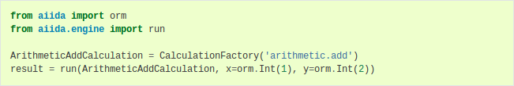
Launching processes
Four processes launchers with identical interface
run Run blockingly and return result
run_get_node Run blockingly and return result + node
run_get_pk Run blockingly and return result + pk
submit Submit to daemon and return node
Run blockingly in the current interpreter
Notes:
Don't forget to update your name on the right

Slide 20
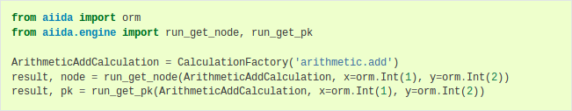
Launching processes
Four processes launchers with identical interface
run Run blockingly and return result
run_get_node Run blockingly and return result + node
run_get_pk Run blockingly and return result + pk
submit Submit to daemon and return node
Run variants to get the process node or pk in addition to the result
Notes:
Don't forget to update your name on the right

Slide 21
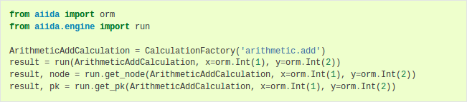
Launching processes
Four processes launchers with identical interface
run Run blockingly and return result
run_get_node Run blockingly and return result + node
run_get_pk Run blockingly and return result + pk
submit Submit to daemon and return node
Variants are available as attributes on run launcher requiring only single import
Notes:
Don't forget to update your name on the right

Slide 22
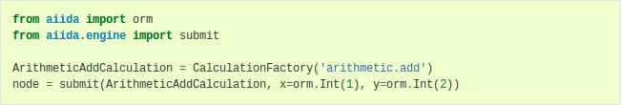
Launching processes
Four processes launchers with identical interface
run Run blockingly and return result
run_get_node Run blockingly and return result + node
run_get_pk Run blockingly and return result + pk
submit Submit to daemon and return node
Submit to the daemon to immediately regain control of the interpreter
Notes:
Don't forget to update your name on the right

Slide 23
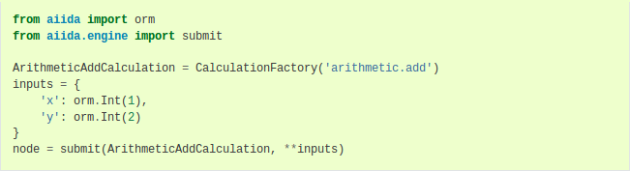
Launching processes
Four processes launchers with identical interface
run Run blockingly and return result
run_get_node Run blockingly and return result + node
run_get_pk Run blockingly and return result + pk
submit Submit to daemon and return node
Can use dictionary with keyword expansion in case of many inputs
Notes:
Don't forget to update your name on the right

Slide 24
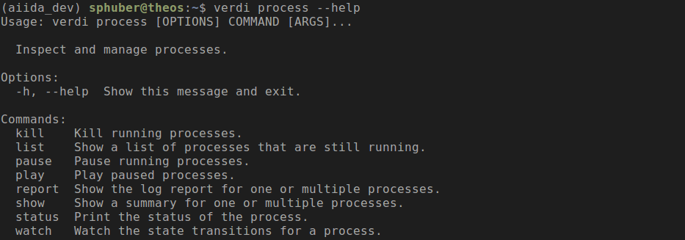
Command line interaction: verdi process
Your one-stop-shop for inspecting and interacting with processes
Notes:
Don't forget to update your name on the right

Slide 25
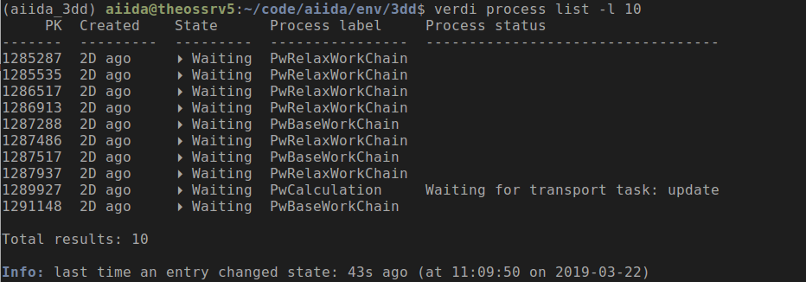
Command line interaction: verdi process
Your one-stop-shop for inspecting and interacting with processes
verdi process list: list active and terminated processes
Notes:
Don't forget to update your name on the right

Slide 26
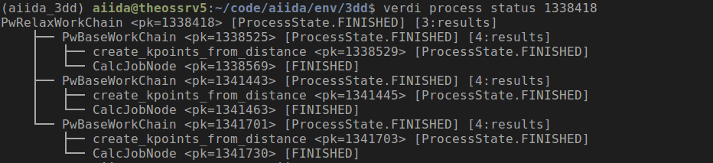
Command line interaction: verdi process
Your one-stop-shop for inspecting and interacting with processes
verdi process status: tree representation of call stack
Notes:
Don't forget to update your name on the right

Slide 27
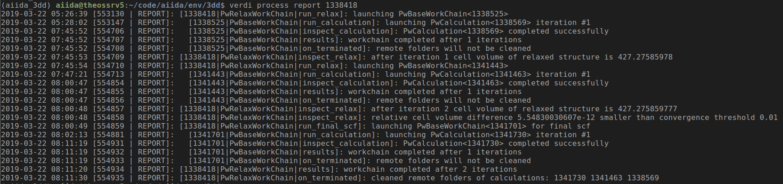
Command line interaction: verdi process
Your one-stop-shop for inspecting and interacting with processes
verdi process report: complete report of log messages and scheduler stdout/stderr
Notes:
Don't forget to update your name on the right

Slide 28
Command line interaction: verdi process
Your one-stop-shop for inspecting and interacting with processes
verdi process pause: pause an active process
verdi process play: resume a paused process
verdi process kill: kill an active process
verdi process pause/play/kill: fails if process is already terminated
Notes:
Don't forget to update your name on the right

Slide 29


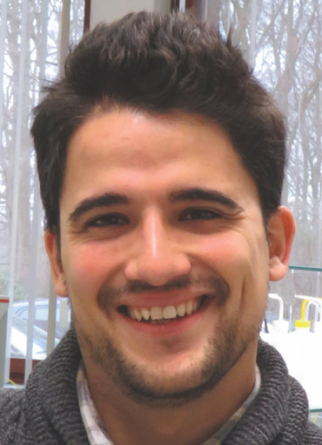
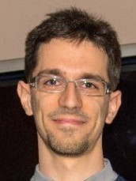
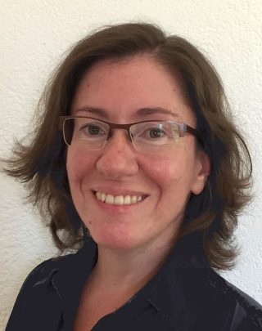

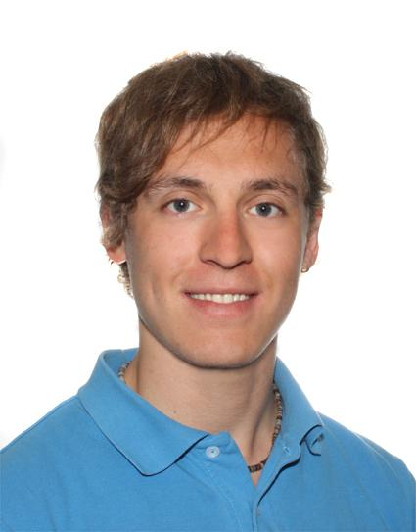
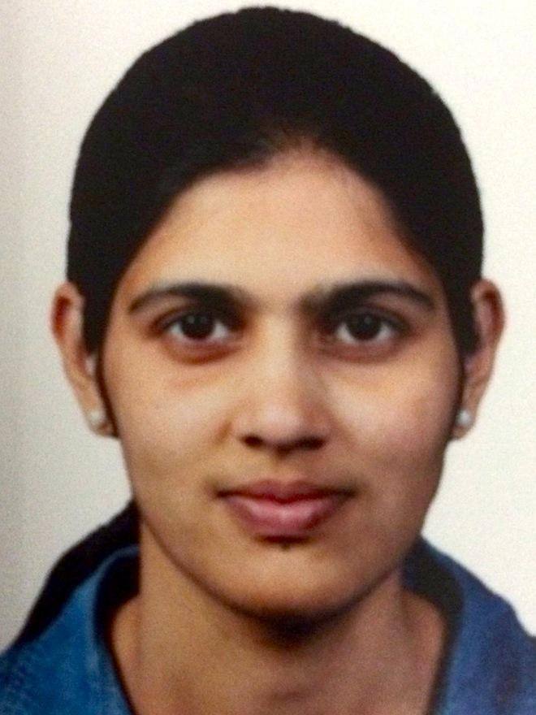
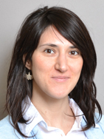

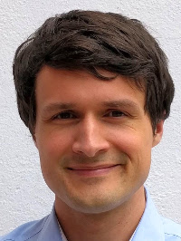


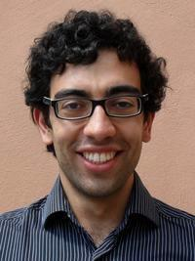
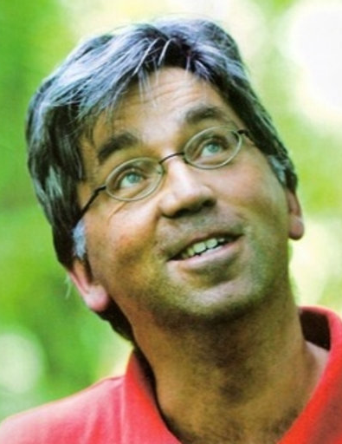


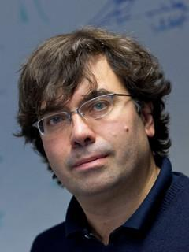
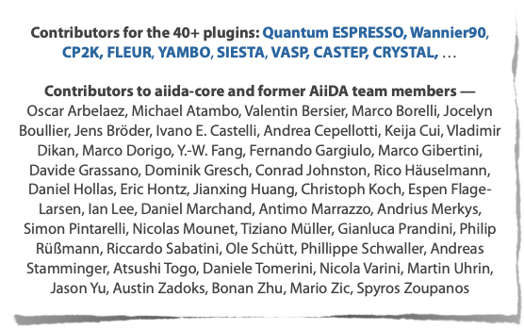
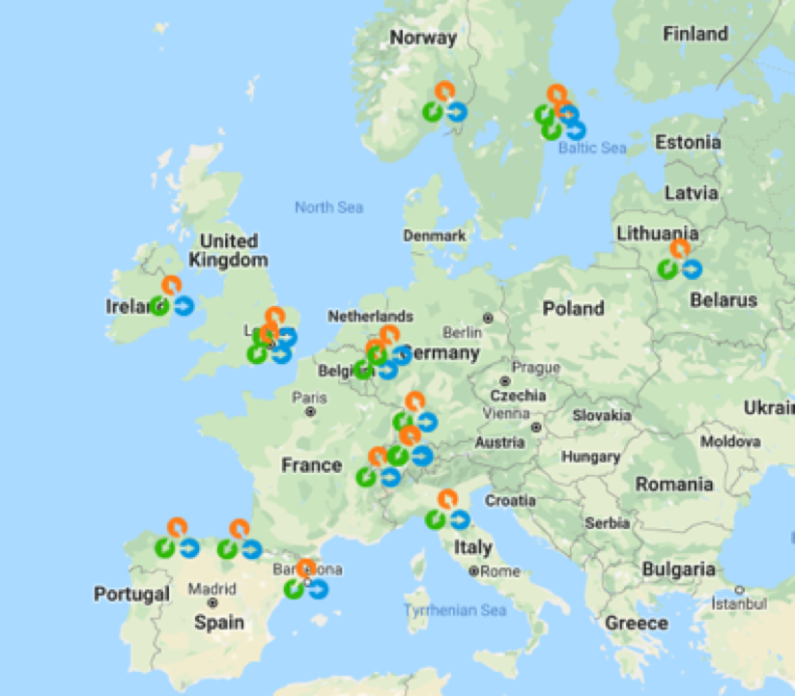
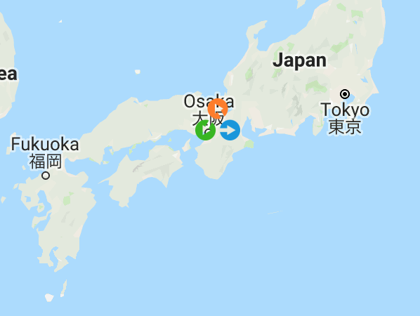
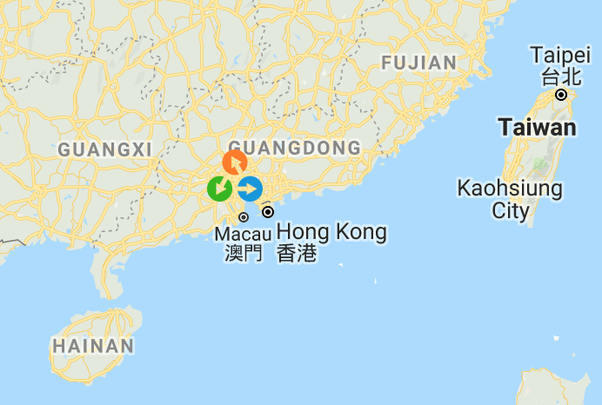
Developers
Carl Simon Adorf
(EPFL)
Casper W.
Andersen
(EPFL)
Marnik
Bercx
(EPFL)
Marco
Borelli
(EPFL)
Valeria Granata
(EPFL)
Sebastiaan P. Huber
(EPFL)
Leonid Kahle
(EPFL)
Snehal P. Kumbhar
(EPFL)
Elsa
Passaro
(EPFL)
The Materials Cloud
And AiiDA teams
Francisco F. Ramirez
(EPFL)
Leopold
Talirz
(EPFL)
Aliaksandr
Yakutovich
(EPFL)
Chris
Sewell
(EPFL)
Giovanni Pizzi
(EPFL)
Berend Smit
(EPFL)
Joost
VandeVondele
(ETHZ,CSCS)
Thomas
Schulthess
(ETHZ,CSCS)
Nicola Marzari
(EPFL)
AiiDA contributors

